Slide 1
My portfolio
Alumo Hessein

Slide 2
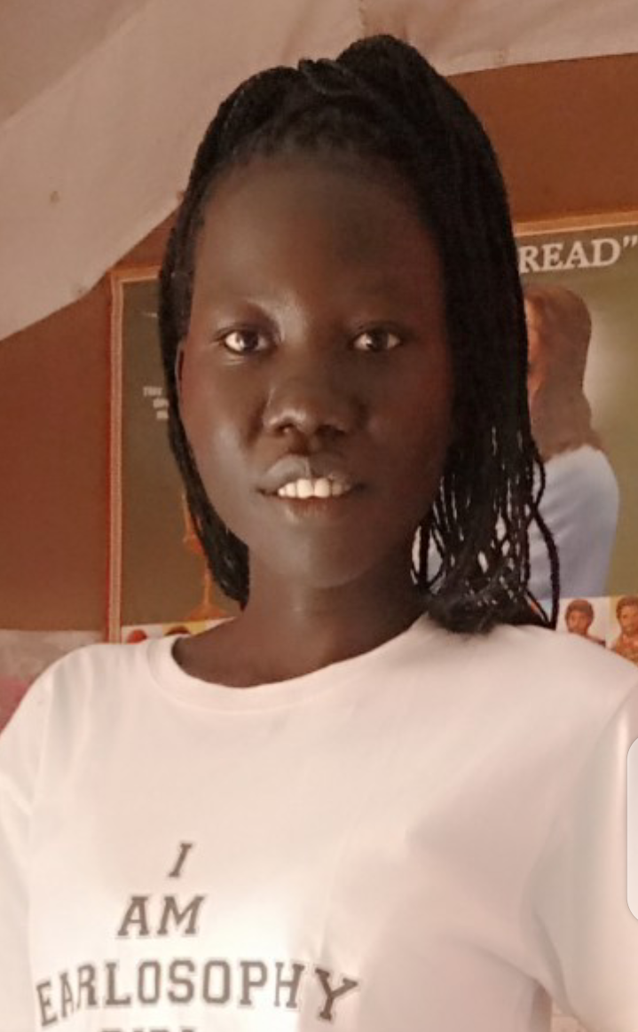
I’m a graphic designer focused on creating visually engaging and user-friendly designs. Passionate about blending creativity with strategy, I’m constantly evolving my skills to deliver high-quality, impactful work. Let’s connect and bring your vision to life!
About me

Slide 3
Skills
Technical skills
Software skills
Typography
Color theory
Photo editing
Layout and composition
Canva
Sketch
Procreate
Time management

Slide 4
My project

Slide 5


Logos

Slide 6
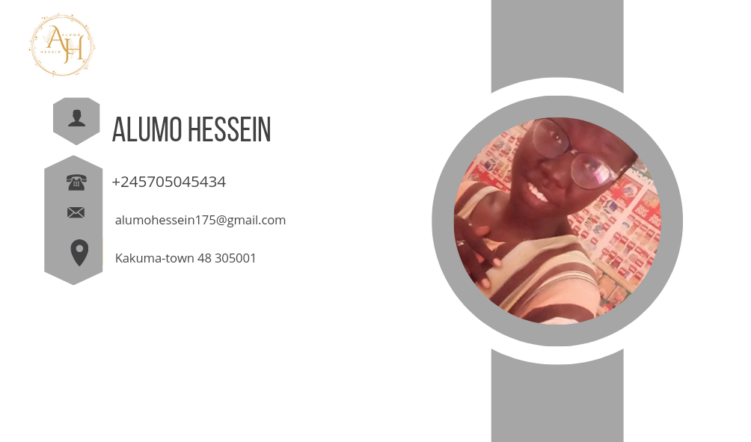

Business card

Slide 7
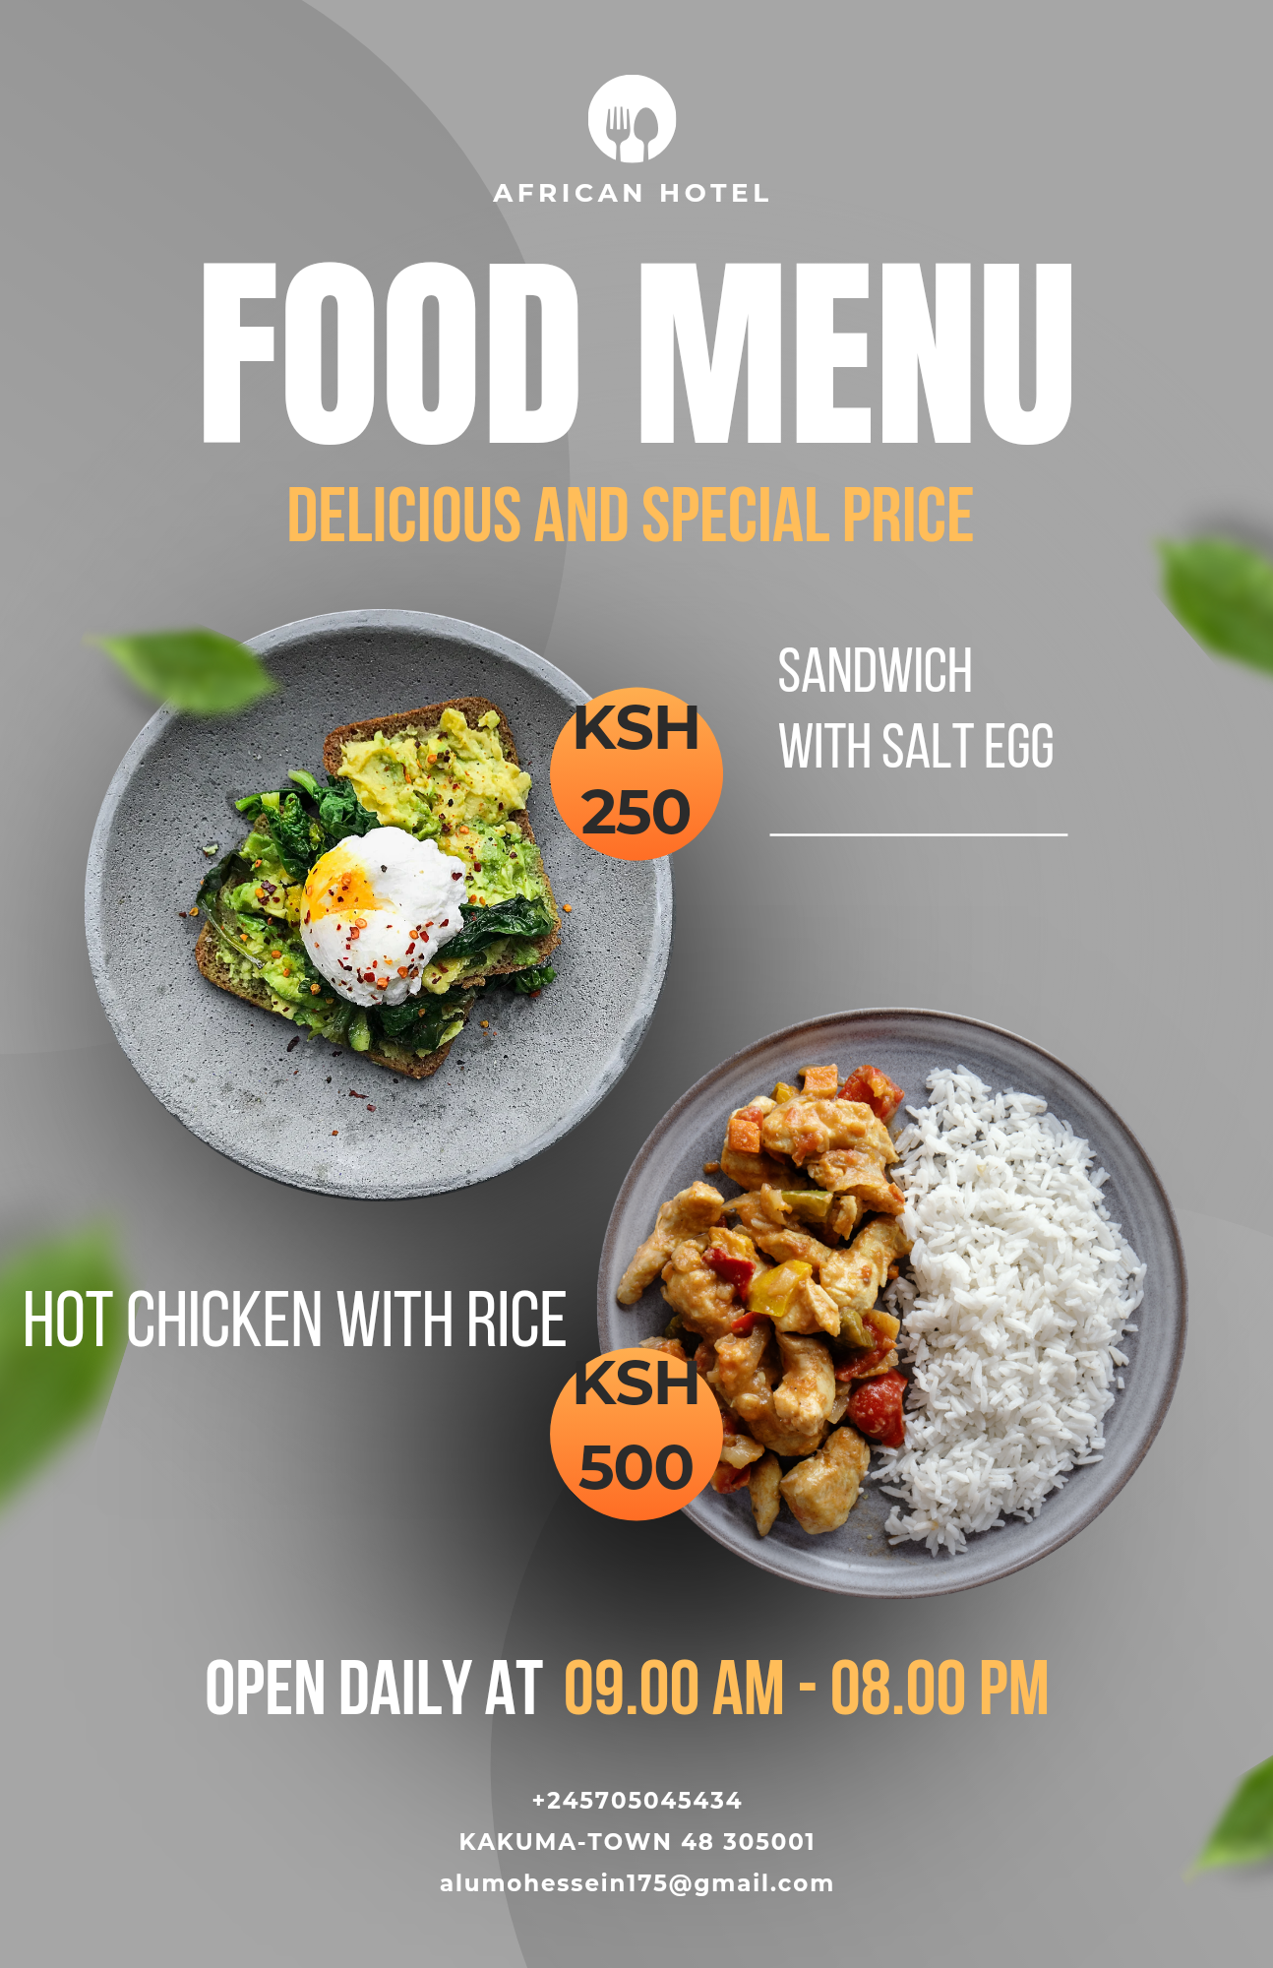
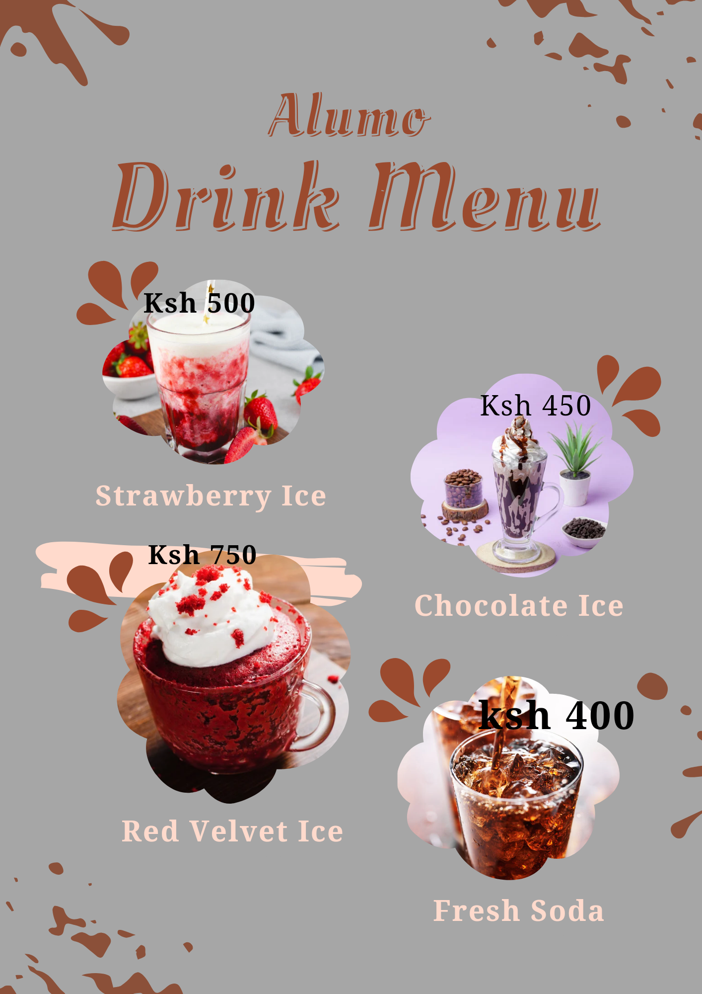
Menu

Slide 8

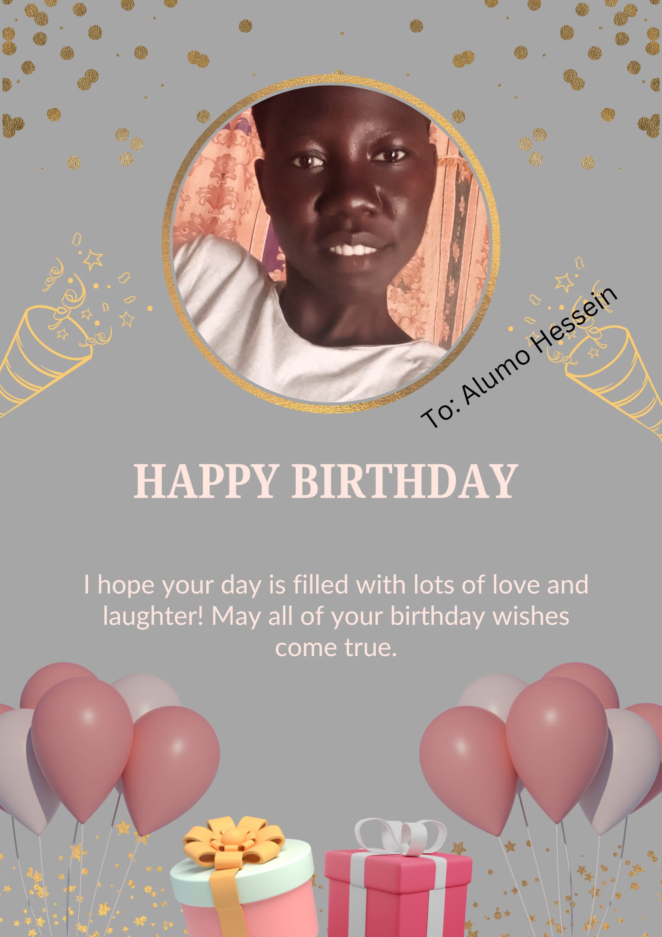
Poster

Slide 9
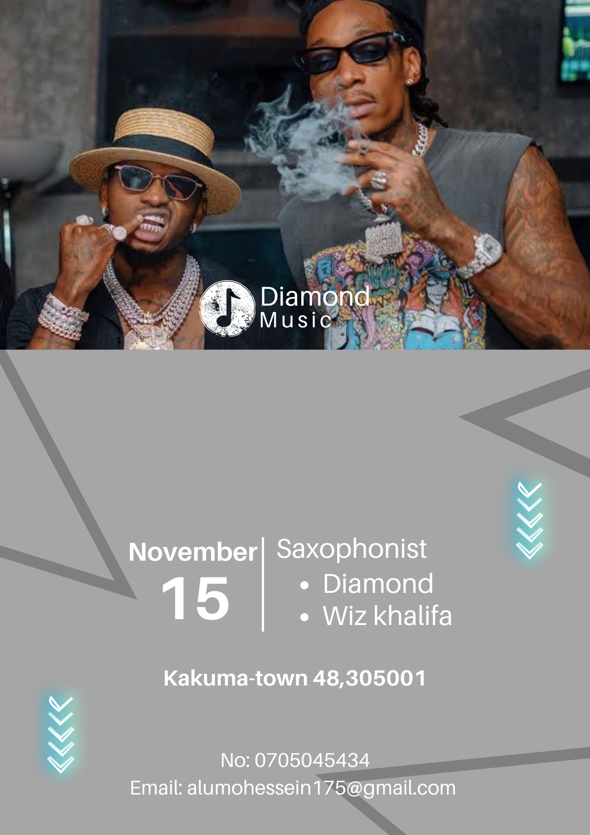
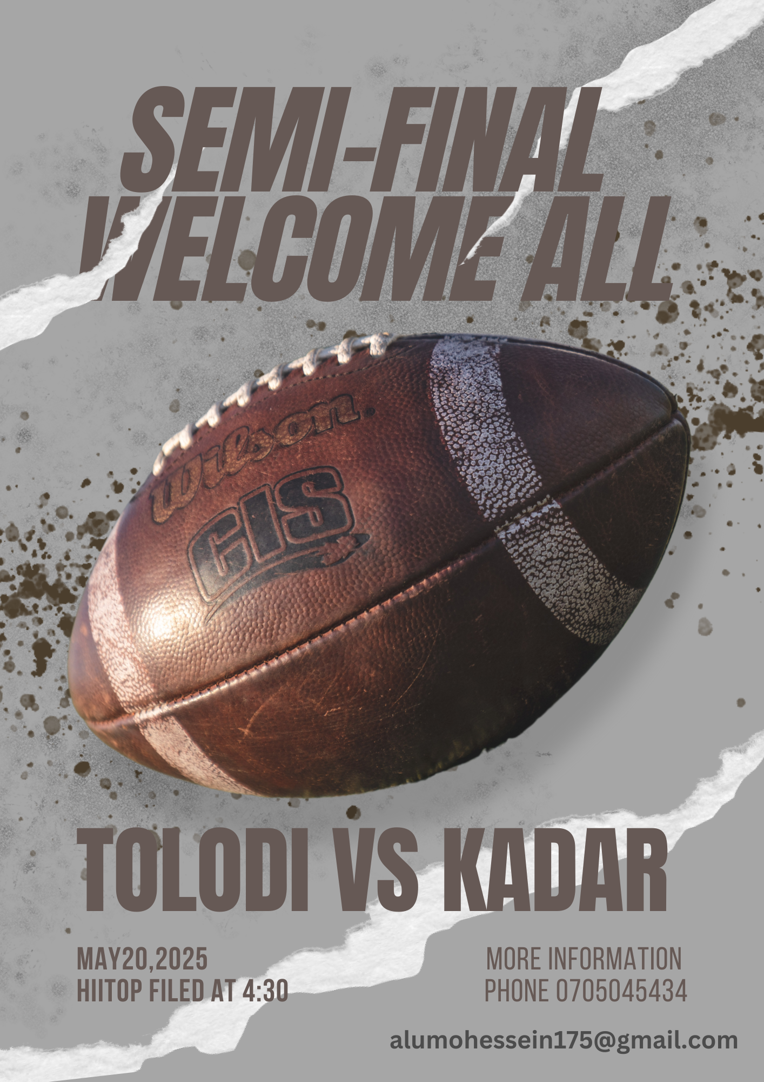
Flyer

Slide 10
Contact
Phone no: 0705045434
Email: alumohessein175@gmail.com

Slide 11
Thank you

